Slide 1
GPU programming in A High Level Language
Compiling X10 to CUDA
Dave Cunningham, Rajesh Bordawekar, Vijay Saraswat
June 2011

Slide 2
Why Program GPUs with X10?
Why program the GPU at all?
Many times faster for certain classes of applications
Hardware is cheap and widely available (as opposed to e.g. FPGA)
Why write X10 (instead of CUDA/OpenCL)?
Use the same programming model (APGAS) on GPU and CPU
Easier to write parallel/distributed GPU-aware programs
Better type safety
Higher level abstractions => fewer lines of code

Slide 3
X10/GPU Programming Experience
GPU programming will never be as easy as CPU.
We try to make it as easy as possible.
Correctness
Can debug X10 kernel code on CPU first, using standard techniques
Static errors avoid certain classes of faults.
Goal: Eliminate all GPU segfaults with negligible overhead.
  Currently detect all dereferences of non-local data (place errors)
  TODO: Static array bounds checking
  TODO: Static null-pointer checking
Performance: Need understanding of the CUDA performance model
Must know advantages+limitations of [registers, SHM, global memory]
Avoid warp divergence
Avoid irregular/misaligned memory access
Use CUDA profiling tool to debug kernel performance (very easy and usable)
Can inspect and disassemble generated cubin file
Easier to tune blocks/threads using auto-configuration
TODO: high-level language features could help here

Slide 4
Why target CUDA and not OpenCL?
In early 2009, OpenCL support was limited
CUDA is based on C++
OpenCL based on C
C++ features help us implement X10 features (e.g. generics)
By targeting CUDA we can re-use parts of existing C++ backend
CUDA evolving fast, more interesting for high level languages (e.g. OOP)
However there are advantages in OpenCL too...
We could support it in future

Slide 5
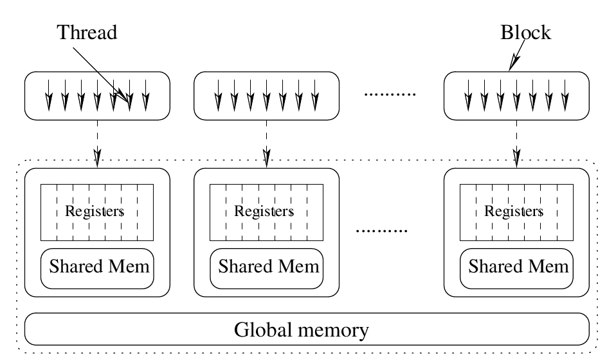
APGAS model ↔ GPU model
GPU / host divide
finish
kernel invocation
blocks
at
Shared mem
Constant mem
Local mem
threads
async
next
DMAs
Java-like sequential constructs
__syncthreads()

Slide 6
GPU / Host divide
High Perf. Network
Host
Host
Host
Host
PCI bus
CUDA
CUDA
CUDA
CUDA
CUDA
A 'place' in
APGAS model
Goals
Re-use existing language concepts wherever possible
Separate GPU memory space ⇒ new place
Place count and topology unknown until run-time
Same X10 code works on different run-time configurations
Could use same approach for OpenCL, Cell, FPGA, …

Slide 7
X10/CUDA code (mass sqrt example)
for (host in Place.places()) at (host) {
val init = new Array[Float](1000, (i:Int)=>i as Float);
val recv = new Array[Float](1000);
for (accel in here.children().values()) {
val remote = CUDAUtilities.makeRemoteArray[Float](accel, 1000, (Int)=>0.0f);
val num_blocks = 8, num_threads = 64;
finish async at (accel) @CUDA {
finish for (block in 0..(num_blocks-1)) async {
clocked finish for (thread in 0..(num_threads-1)) clocked async {
val tid = block*num_threads + thread;
val tids = num_blocks*num_threads;
for (var i:Int=tid ; i<1000 ; i+=tids) {
remote(i) = Math.sqrtf(init(i));
} } } }
// Console.OUT.println(remote(42));
finish Array.asyncCopy(remote, 0, recv, 0, recv.size);
Console.OUT.println(recv(42));
}
}
Discover GPUs
Alloc on GPU
GPU code
Implicit capture
and transfer to GPU
Static type error
Copy result to host

Slide 8
Kernel Structure
Enforces language restrictions
finish async at (p) @CUDA {
finish for (block in 0..(blocks-1)) async {
clocked finish for (thread in 0..(threads-1)) clocked async {
val tid = block*threads + thread;
val tids = blocks*threads;
for (var i:Int=tid ; i<len ; i+=tids) {
remote(i) = Math.sqrtf(init(i));
}
}
}
}
CUDA kernel
Define kernel shape
CUDA block
CUDA thread
Only sequential code
Only primitive types / arrays
No allocation, no dynamic dispatch

Slide 9
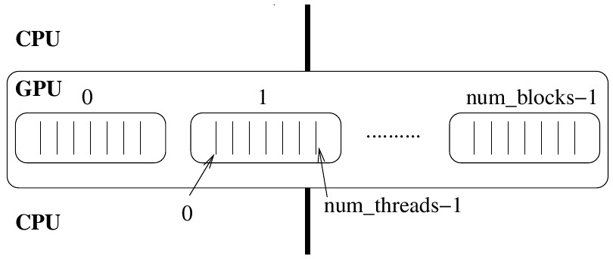
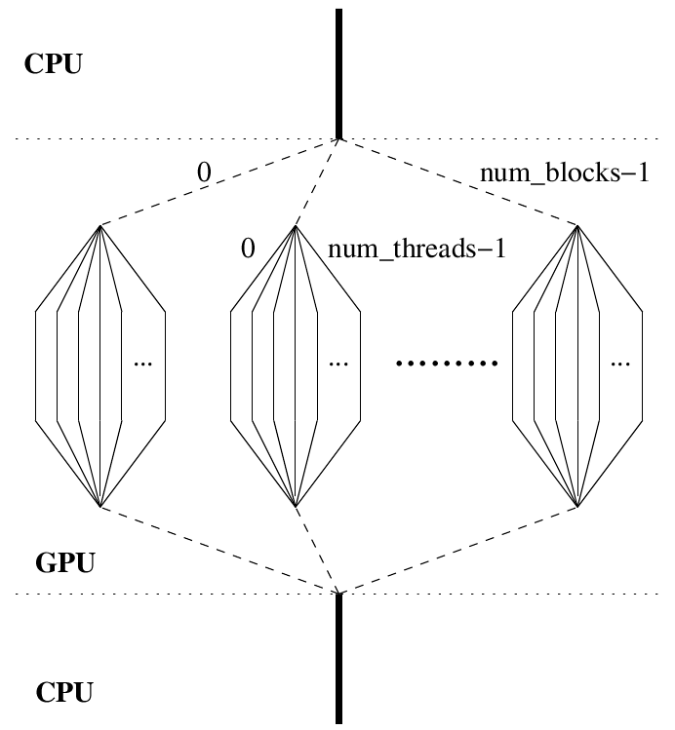
__global__ void kernel (...)
{
...
}
kernel<<<num_blocks,num_threads>>>(...)

Slide 10
Dynamic Shared Memory & barrier
Compiled to CUDA
'shared' memory
finish async at (p) @CUDA {
finish for (block in 0..blocks-1) async {
val shm = new Array[Int](threads, (Int)=>0);
clocked finish for ((thread) in 0..threads-1) clocked async {
shm(thread) = f(thread);
next;
val tmp = shm((thread+1) % threads);
} } }
Initialised on GPU
(once per block)
CUDA barrier
represented
with clock
General philosophy:
Use existing X10 constructs to express CUDA semantics
APGAS model is sufficient

Slide 11
Constant cache memory
Compiled to CUDA
'constant' cache
val arr = new Array[Int](threads, (Int)=>0);
finish async at (p) @CUDA {
val cmem : Sequence[Int] = arr.sequence();
finish for (block in 0..(blocks-1)) async {
clocked finish for ((thread) in 0..(threads-1)) clocked async {
val tmp = cmem(42);
} } }
Automatically uploaded
to GPU (just before
kernel invocation)
('Sequence' is an immutable array)
General philosophy:
Quite similar to 'shared' memory
Again, APGAS model is sufficient

Slide 12
Blocks/Threads auto-config
Maximise 'occupancy'
at run-time according to
a simple heuristic
finish async at (p) @CUDA {
val blocks = CUDAUtilities.autoBlocks(),
threads = CUDAUtilities.autoThreads();
finish for (block in 0..(blocks-1)) async {
clocked finish for (thread in (0..threads-1)) clocked async {
// kernel cannot assume any particular
// values for 'blocks' and 'threads'
}
}
}
If called on the CPU, autoBlocks() == 1, autoThreads() == 8

Slide 13
KMeansCUDA kernel
Cache clusters in SHM
finish async at (gpu) @CUDA {
val blocks = CUDAUtilities.autoBlocks(),
threads = CUDAUtilities.autoThreads();
finish for ([block] in 0..(blocks-1)) async {
val clustercache = new Array[Float](num_clusters*dims, clusters_copy);
clocked finish for ([thread] in 0..(threads-1)) clocked async {
val tid = block * threads + thread;
val tids = blocks * threads;
for (var p:Int=tid ; p<num_local_points ; p+=tids) {
var closest:Int = -1;
var closest_dist:Float = Float.MAX_VALUE;
@Unroll(20) for ([k] in 0..num_clusters-1) {
var dist : Float = 0;
for ([d] in 0..(dims-1)) {
val tmp = gpu_points(p+d*num_local_points_stride)
- clustercache(k*dims+d);
dist += tmp * tmp;
}
if (dist < closest_dist) {
closest_dist = dist;
closest = k;
}
}
gpu_nearest(p) = closest;
}
}
}
}
Drag inputs from host each iteration
Strip-mine outer loop
SOA form to allow regular accesses
Unroll this loop
Allocated earlier
(via CUDAUtilities)
Pad for alignment (stride includes padding)
Above Kernel is only part of the story...
Use kernel once per iteration of Lloyd's Alg.
Copy gpu_nearest to CPU when done
Rest of algorithm runs faster on the CPU!

Slide 14
K-Means End-to-End Performance
Hosts x GPUs (per host)
Colours show scaling up to 4 Tesla GPUs
  Y-axis gives Gflops normalized WRT native CUDA implementation (single GPU, host)
2M/4M points, K=100/400, 4 dimensions
  Higher K ⇒ more GPU work ⇒ better scaling
Analysis
Performance sensitive to many factors:
  CPU code: fragile g++ optimisations
  X10/CUDA DMA bandwidth (GPUs share PCI bus)
  Infiniband for host<->host communication (also share PCI bus)
  nvcc register allocation fragile
Outstanding DMA issue (~40% bandwidth loss)
  CUDA requires X10 CPU objects allocated with cudaMalloc
  Hard to integrate with existing libraries / GC
  Currently staging DMAs through pre-allocated buffer...
  complaints by users on CUDA forums
Options for further improving performance:
  Use multicore for CPU parts
  Hide DMAs

Slide 15
Future Work
Support texture cache...
  Explicit allocation: val t = Texture.make(...)
  at (gpu) { … t(x, y) … }
Fermi architecture presents obvious opportunities for supporting X10
  Indirect branches ⇒ Object orientation and Exceptions
  NVidia's goal is the same as ours – allow high level GPU programming
OpenCL
  No conceptual hurdles
  Different code-gen and runtime work
  X10 programming experience should be very similar
Memory Allocation on GPU
  Latest CUDA has a 'malloc' call we might use
GPU GC cycle between kernel invocations
  A research project in itself
atomic operations
GL interoperability

